Slide 1

Paper ID:ICOEI374 Paper Title: A Comparative Analysis of Weapon Detection Using Various Deep Learning Techniques.
7th International Conference on Trends in Electronics and Informatics (ICOEI 2023)
Organized By: SCAD College of Engineering and Technology,
Tirunelveli, India
SCAD College of Engineering and Technology, Cheranmahadevi, Tirunelveli, India
Presented by:
Shreyas Mandavkar

Slide 2
Table of Content
Introduction
Related Work
Methodology
Result
Conclusion
References

Slide 3
Abstract
Deep Learning approaches for solving the problem created a revolution in the field of research. An example like scene interpretation which includes the detection, classification, and recognition of objects.
This study paper will cover the various new models of deep learning techniques in detecting and classifying objects from the scene.

Slide 4
Introduction:
Assault is a serious crime that can have severe consequences for the perpetrator.
Weapon detection is an important issue for public safety and security.
By using deep learning algorithms, it is possible to develop models that can accurately identify weapons in real-time.
This can be done using an image or video analysis, where the algorithm is trained on a dataset of images or videos that include weapons and other objects.
The proposed system aims to assist the police in detecting and identifying weapons in a variety of settings, including outdoor scenes.
By using machine learning algorithms to analyze visual information, the system can potentially help the police to more efficiently and accurately identify weapons.

Slide 5
Literature Review:
Authors | Research Work/Model | Research Work/Model
Neil Shah, Nandish Bhagat, and Manan Shah | Crime forecasting: a machine learning and computer vision approach to crime prediction and prevention(2021) | The authors here aimed to study how law enforcement agencies or authorities might employ a mix of ML and computer vision to detect, prevent, and solve crimes much more accurately and quickly.
Dr. N. Geetha, Akash Kumar. K. S, Akshita. B. P, Arjun. M | Weapon Detection in Surveillance System: International Journal of Engineering Research & Technology (IJERT), May-2021. | The You Look Only Once (YOLOv3) algorithm was implemented to find weapons in real-time footage. In conclusion, the yolov3 algorithm outperforms the earlier CNN, R-CNN, and faster CNN algorithms in terms of speed.
Sivaranjani, S., S. Sivakumari, and M. Aasha. | Crime prediction and forecasting in TamilNadu using clustering approaches." Emerging Technological Trends (ICETT), International Conference on. IEEE, 2016. | The authors used the Naive Bayes classifiers algorithm, a supervised learning and statistical approach for classification that has a 90% accuracy rate, to classify the data.
Chen, Ling, and Xu Lai. | Comparison between ARIMA and ANN models used in short-term wind speed forecasting." Power and Energy Engineering Conference (APPEEC), 2011 Asia Pacific. IEEE, 2011. | The authors compared the experimental results generated using an Artificial Neural Network (ANN) and Autoregressive Integrated Moving Average (ARIMA).

Slide 6
Authors | Research Work/Model | Research Work/Model
Vaidehi, K., Subashini, T. | Automatic classification and retrieval of mammographic tissue density using texture features. In: 2015 IEEE 9th International Conference | It presents a method for the automatic classification and retrieval of mammographic tissue density using texture features. The proposed method has the potential to improve accuracy and lead to earlier detection in breast cancer diagnosis and treatment.
Sidhu, R.S., Sharad, M. | Smart surveillance system for detecting interpersonal crime. In: 2016 International Conference on Communication and Signal Processing (ICCSP), pp. 2003–2007. IEEE (2016). | The system can detect a range of criminal behaviors, including physical altercations, suspicious activity, and aggressive behavior. The authors tested the system in a real-world setting and found that it was effective at detecting interpersonal crime.
Li, J., Ye, D.H., Chung, T., Kolsch, M., Wachs, J., Bouman, C. | Multi-target detection and tracking from a single camera in unmanned aerial vehicles (UAVs). In: 2016 IEEE/RSJ International Conference on Intelligent Robots and Systems (IROS), pp. 4992–4997. IEEE (2016). | The paper presents a promising approach to multi-target detection and tracking from a single camera in UAVs, which could have significant practical applications.
Herrmann, C., Beyerer, J. | Face retrieval on large-scale video data. In: 2015 12th Conference on Computer and Robot Vision (CRV), pp. 192–199. IEEE (2015). | The authors conducted a promising approach to face retrieval on large-scale video data, which could have significant implications for video surveillance and security.

Slide 7
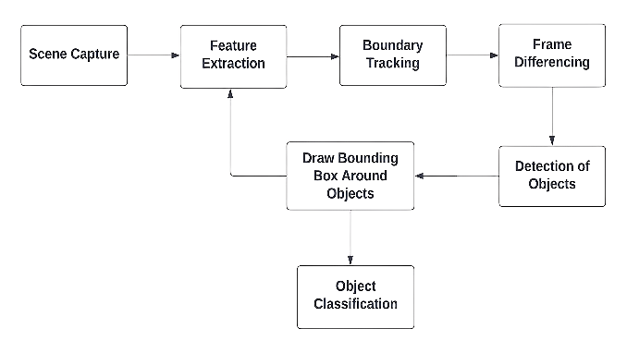
Methodology
Dataset
The dataset was annotated using roboflow, with rectangular bounding boxes manually added to the images. The dataset had 3 classes: weapon, knife, and person, with an approximately equal number of images in each class.
Fig.1 Explains the workflow of the system.

Slide 8
Implementation
The proposed system was implemented using three algorithms that are – YOLOv5, RCNN, and SSD.
YOLOv5 – YOLOv5 (You Look Only Once) uses Cross Stage Partial Networks (CSP) to extract instructive information from input images. The model neck generates feature pyramids (FP) and anchor boxes are utilized for feature class probabilities. Hyperparameters, such as batch size and learning rate, are used to control the model's architecture, training, and performance. YOLOv5 has 50 hyperparameters with a batch size of 16 and a learning rate of 0.001.
RCNN – RCNN (Region-based Convolutional Neural Network) is based on visual data of images. The hyperparameters for the R-CNN algorithm were 100 with a similar batch size and learning rate as the YOLOv5 algorithm.
SSD – The SSD (Single Shot Detector) technique extracts information from each grid cell using a sequence of convolutional and pooling layers. Each grid cell is then subjected to a classifier to forecast. The hyperparameters for the SSD algorithm were 150 with a similar batch size and learning rate as the YOLOv5 algorithm.

Slide 9
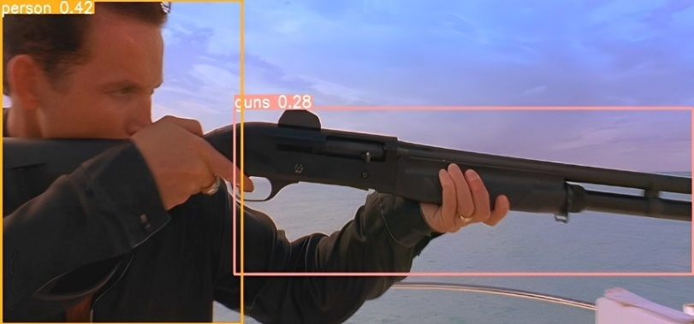
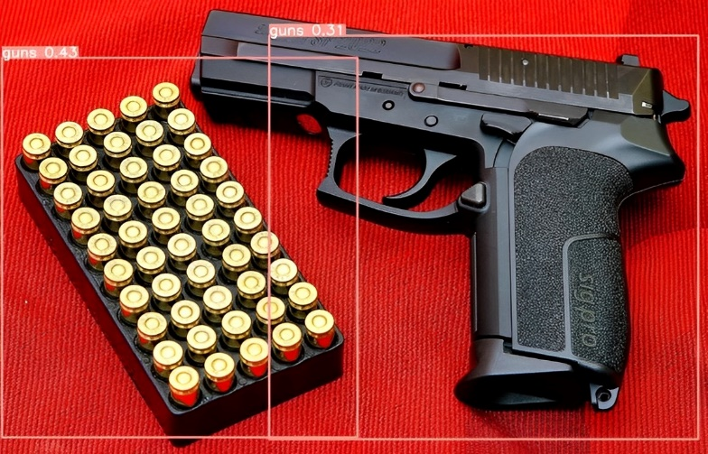
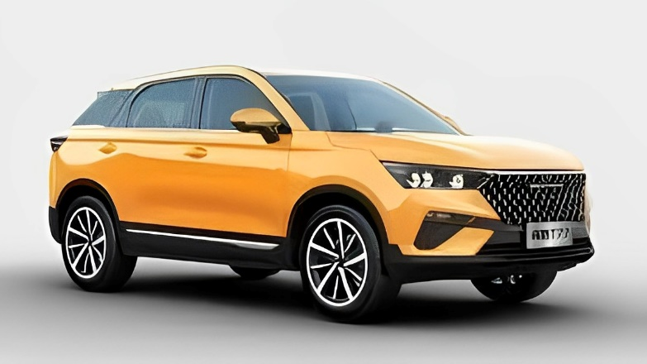
Performance Metrics
Our systems were evaluated based on various performance metrics, such as true positive results, true negative results, and false positive results, among others. In addition, we calculated the mean average precision (mAP) value to compare the performance of our system.
Fig.2. Image for True Positive Result
Fig.3. Image for False Positive Result
Fig.4. Image for True Negative Result

Slide 10
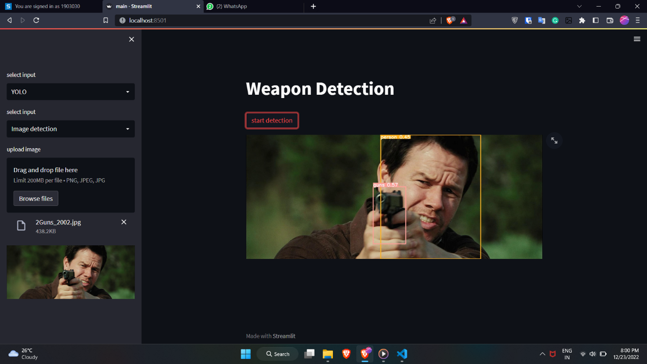

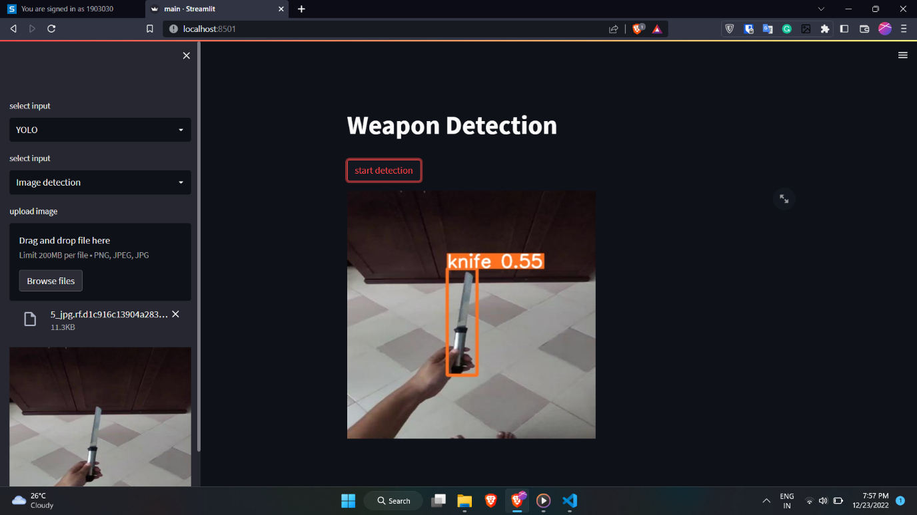
User Interface
Fig.11 user interface

Slide 11
Results
The results were evaluated in terms of true positive detections. As evidenced by a high mAP (mean average precision) score of 56% for small objects. This suggests that the YOLOv5 is known for its robustness in accurately detecting small and difficult-to-see objects in video footage.
Similarly, the SSD model is known for its ability to perform well in detecting small and blurry objects in video footage, as indicated by the high mAP score of 37% for small objects.
The RCNN model performed well in detecting small and blurry objects in video footage, as indicated by the high mAP score of 47% for small objects.
Models | YOLO v5 | SSD | RCNN
Map value (Mean Average Precision Value) | 56.2 | 36.7 | 47.1
Table 1. Comparative analysis of map values

Slide 12
Conclusion
We used YOLOv5, RCNN, and SSD as different models for image processing and computer vision, and we are comparing their performance on our dataset.
As mentioned YOLOv5 has the best prediction accuracy, but it was slower than the other two models.
The YOLOv5 model included an affine-tuning approach to optimize its performance, and YOLOv5 has improved compared to previous versions and RCNN can be more accurate but slower.
Ultimately, the choice between YOLOv5 and RCNN depends on the specific use case and the trade-off between accuracy and speed that is acceptable for the application.

Slide 13
Reference
[1] Reagan L. Galvez; Argel A. Bandala; Elmer P. Dadios; Ryan Rhay P. Vicerra; Jose Martin Z. Maningo: TENCON 2018 - 2019 IEEE Region 10 Conference.
[2] Joseph Redmon, Santosh Divvala, Ross Girshick, Ali Farhadi: You Only Look Once: Unified, Real-Time Object Detection: IEEE conference on computer vision and pattern recognition (2016).
[3] Wei Fan, Zhenying Xu, Ziqian Wu: Improved SSD-assisted algorithm for surface defect detection of electromagnetic luminescence(2021).
[4] Razavian, A.S., Sullivan, J., Carlsson, S., Maki, A.: Visual instance retrieval with deep convolutional networks. arXiv preprint arXiv:1412.6574 (2014).
[5] Jeff Donahue, Yangqing Jia, Oriol Vinyals, Judy Hoffman, Ning Zhang, Eric Tzeng, Trevor Darrell: DeCAF: A Deep Convolutional Activation Feature for Generic Visual Recognition: arXiv preprint arXiv:1310.1531 (2014).
[6] Oquab, Maxime, Bottou, Léon, Laptev, Ivan, Sivic, Josef, et al. Weakly supervised object recognition with convolutional neural networks. In NIPS, 2014.
[7] Chen, Ling, and Xu Lai. "Comparison between ARIMA and ANN models used in short-term wind speed forecasting." Power and Energy Engineering Conference (APPEEC), 2011 Asia Pacific. IEEE, 2011.
[8] Sivaranjani, S., S. Sivakumari, and M. Aasha. "Crime prediction and forecasting in Tamil Nadu using clustering approaches." Emerging Technological Trends (ICETT), International Conference on. IEEE, 2016.

Slide 14
[9] Dr. N. Geetha, Akash Kumar. K. S, Akshita. B. P, Arjun. M: Weapon Detection in Surveillance System: International Journal of Engineering Research & Technology (IJERT) ISSN: 2278-0181 IJERTV10IS050077 Vol. 10 Issue 05, May-2021.
[10] Neil Shah, Nandish Bhagat and Manan Shah: Crime forecasting: a machine learning and computer vision approach to crime prediction and prevention(2021)
[11] MalavikaNair, Mathew Gillroy, Neethu Jose, and Jasmy Davies in their “i-surveillance Crime Monitoring and Prevention Using Neural Networks”, International Research Journal of Engineering and Technology (IRJET), e-ISSN:2395-0056Volume: 05 03rd March 2018.
[12] jha P,jha R,Sharma A (2019) Behavior analysis and crime prediction using big data and machine learning.Int j Recent Technol Eng 8(1):461-468
[13] Harsh Jain, Aditya Vikram, Mohana, Ankit Kashyap, Ayush Jain Telecommunication Engineering, “Weapon detection using AI and deep learning for security application”, IEEE (2019).
[14] M. K. Mohamed, A. Taha and H. H. Zayed, “Automatic gun detection approach for video surveillance,” International Journal of Socio Technology and Knowledge Development, vol. 12, no. 1, pp. 49–66, 2020.
[15] J. Lim, M. Istiaque, A. Jobayer, V. M. Baskaran, J. M. Lim et al., “Gun detection in surveillance videos using deep neural networks,” in Proc. of APSIPA, Lanzhou, China, vol. 1, no. 1, pp. 1–6, 2019.
[16] Erssa Arif, Syed Khuram Shahzad, Muhammad Waseem Iqbal, Muhammad Arfan Jaffar, Abdullah S. Alshahrani and Ahmed Alghamdi: Automatic Detection of Weapons in Surveillance Cameras Using Efficient-Net (2022).
[17] Karabo Jenga, Cagatay Catal, Gorkem Kar: Machine learning in crime prediction: Journal of Ambient Intelligence and Humanized Computing (2023).

Slide 15
Thank You

